Slide 1
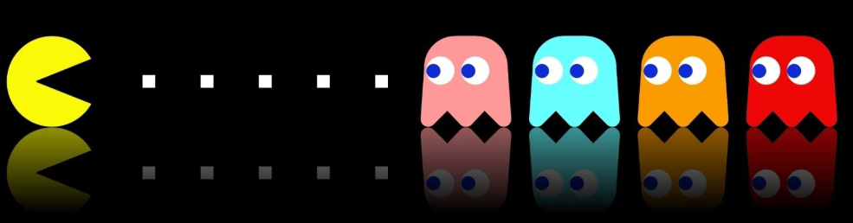
Pacman with Reinforcement Learning
Presentation Subtitle
Adheesh Chatterjee (116236935)
Nithish Kumar S (116316958)

Slide 2
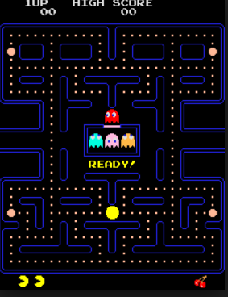
Introduction
Pacman is a game that takes place on a single screen. The player controls the Pacman character and can move him around the maze.
The main goal of the game is to collect all of the pellets in the maze. Once the player has collected all of the pellets, the level is complete, and the game advances to the next level.
There are 4 ghosts that will make it difficult for the player to collect all of the pellets. They will chase the player in various ways and if the player comes into contact with any of the ghosts, the player will die.
When the player loses all of his lives, the game is over. There are 4 power pellets and if the player eats any of these power pellets, then the player can eat the ghosts. When the ghosts get eaten they will respawn.

Slide 3
Overview
The goal of this project is to illustrate how reinforcement learning is applied to the Pacman game to make it play itself. Various approaches have been used to train the game and the algorithms are explained. We have also tested the game on various grid sizes with changed parameters. The learning approaches used are -
Q Learning
Approximate Q Learning
Deep Q Learning

Slide 4
Environment
Berkeley Pacman environment (Easy access of states, rewards. Real time)
Environment class
Current state, doAction, possible Actions, reset
Ghost behaviours
Display graphics
Reward System
+1 Food collection -1 Each step without collecting food
-500 Die +500 Last food

Slide 5

Machine Learning Techniques
Q Learning
Initially, we employed the use of Q Learning to train the model. Q Learning is a method of determining the value of state-action pairs. The Q Value, is represented by Q(S,a), where S is the State and a is the action. This value is generated from the reward received for taking action a.
The learning rate we choose was 0.2 and the discount factor was 0.8.

Slide 6
Epsilon Greedy
We use Epsilon Greedy strategy for exploration. Essentially, it chooses random actions an epsilon fraction of the time and follows its current best Q-values otherwise.
We do this to balance the exploitation-exploration trade-off. Although, this could sometimes under explore the variant space before exploiting what it estimates to be the strongest variant. A possible alternative to epsilon-greedy could be a future scope for this project.
We use an epsilon value of 0.1

Slide 7
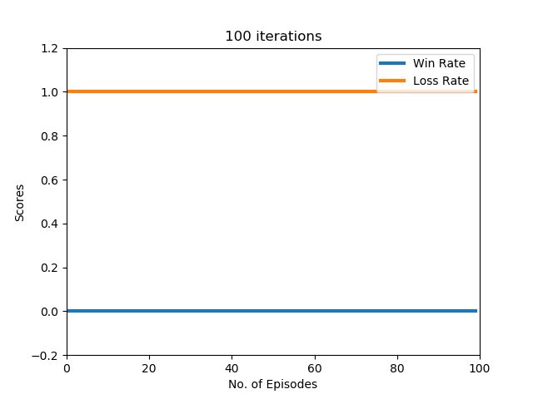
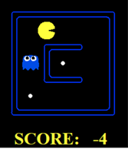
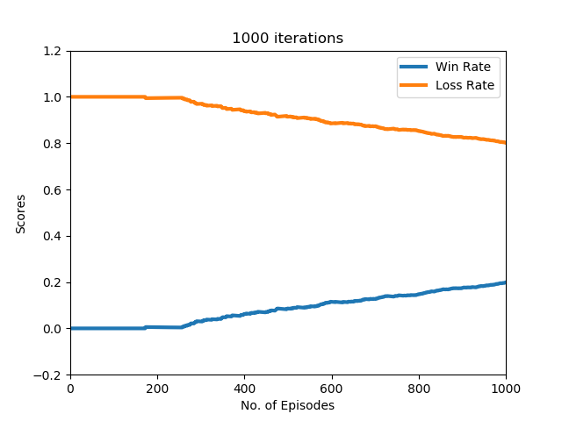
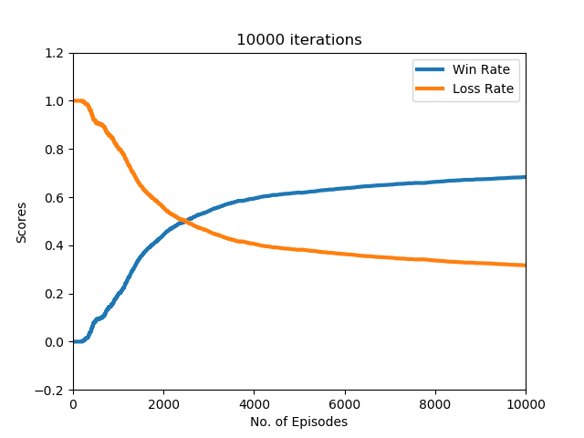

Results
Small Grid
$2^{9}$ states
5 actions

Slide 8
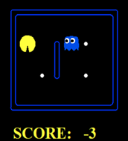
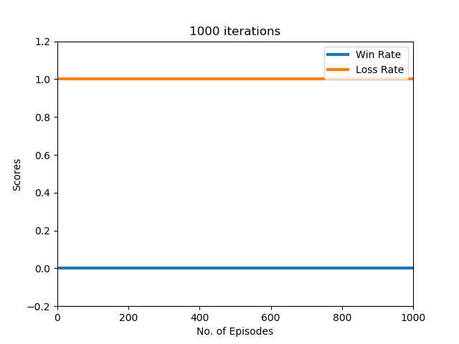
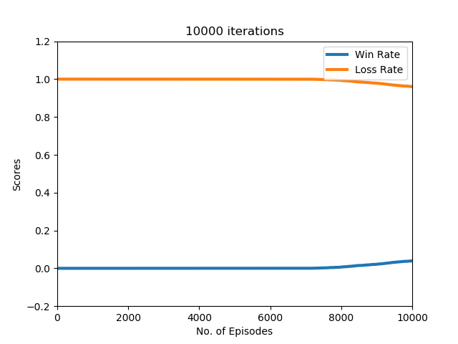

Results
Medium Grid
$2^{16}$ states
5 actions

Slide 9
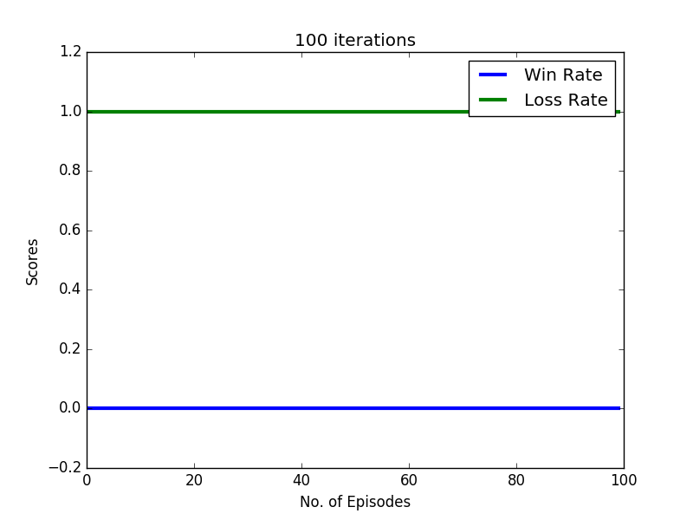
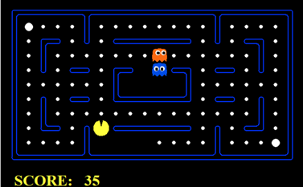

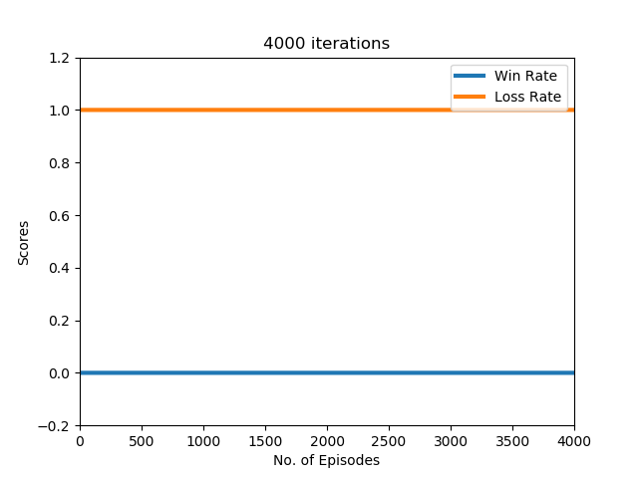

Results
Classic Grid
$2^{144}$ states
5 actions

Slide 10


Functional Approximation
Approximate Q Learning assumes the existence of a feature function f(s,a) over the state and action pairs which will yield a series of vectors f_1 (s,a),f_2 (s,a)…f_n (s,a). In approximate q learning, the Q function is defined as –
The weights get updated according the equation –
The idea here is that the Q value is represented as weighted linear sum of the feature values for the state. After taking an action from a state we go to new state and get a reward. Based on the features, the reward and the next state we update the weights

Slide 11
Feature Picking
We hand pick certain features that we thought would be essential in training the Pacman. We considered -
Distance to closest food
Number of ghosts 1 step away
Distance to closest capsule
Activation of capsule when ghost is nearby
Scared Ghost nearby
Then by using appropriate weights for all these features, the approximate Q Learning is implemented.

Slide 12
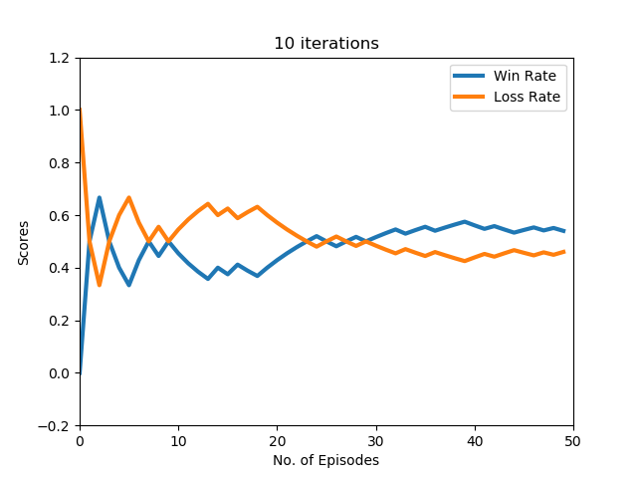
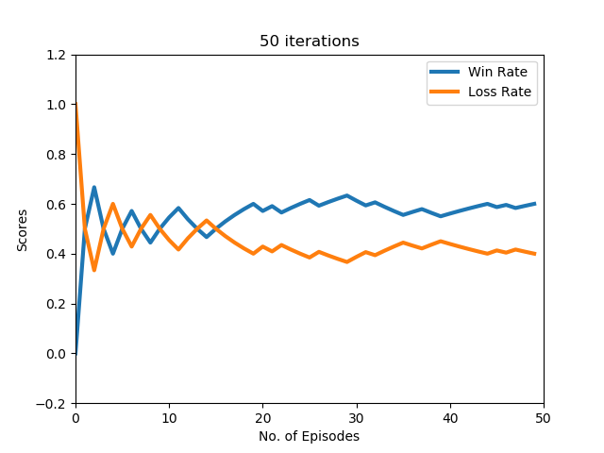
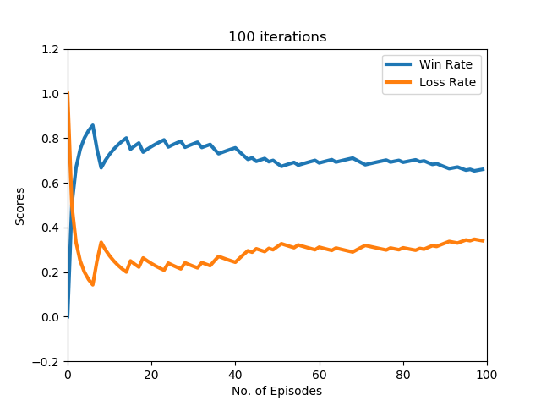
Results
Small Grid
$2^{9}$ states
5 actions

Slide 13
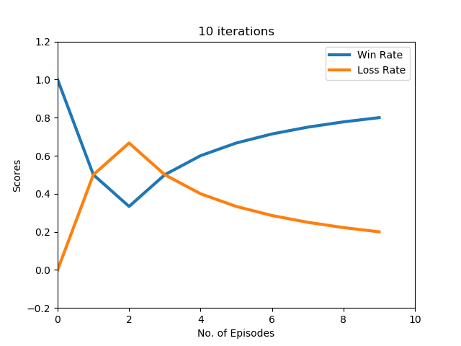
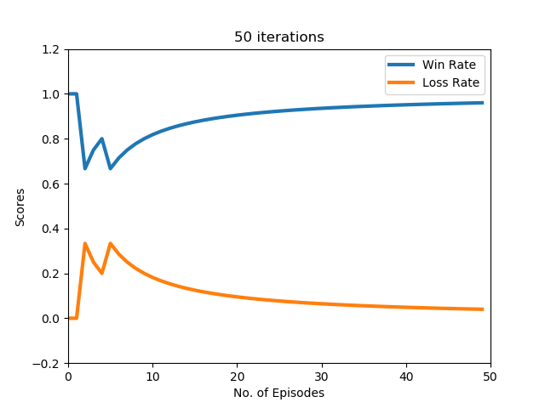
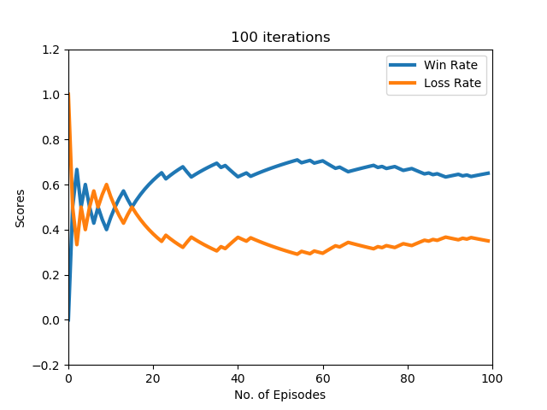
Results
Medium Grid
$2^{16}$ states
5 actions

Slide 14
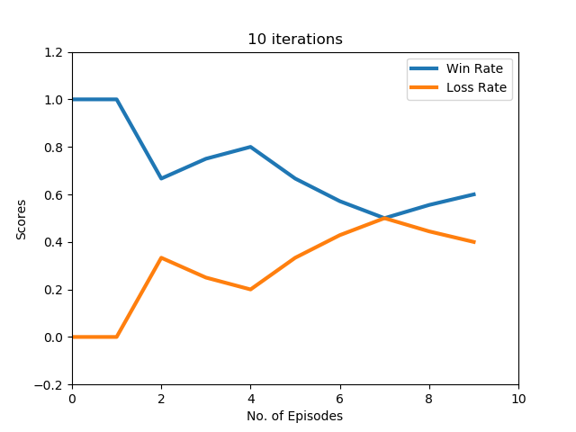
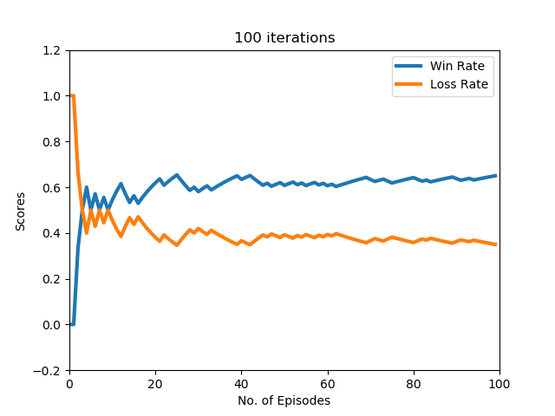
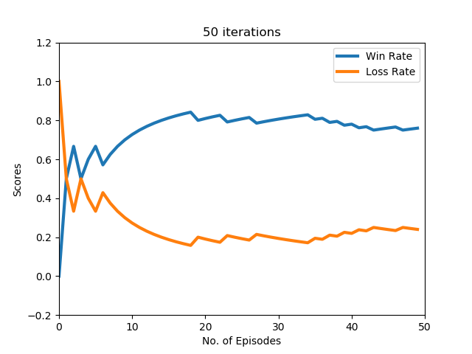
Results
Classic Grid
$2^{144}$ states
5 actions

Slide 15
Deep Q learning
Finally, the Deep Q learning approach was implemented. Deep Q Learning uses Q Learning along with Convolutional Neural Networks to approximate the Q Value.
The Deep Q Learning thus consists of 2 parts -
Setting up the Convolutional Neural Network to take our input and return a trained network
Setting up our environment to input each state into the CNN and generate the Q value based on the 5 possible actions

Slide 16

Setting up the CNN
Tensorflow was used to set up the CNN. We use the CNN algorithm that was originally developed to play Atari games but we make modification to the layers , optimizer and the activation function.
The CNN is composed of 2 convolutional layers, one dense layer and one output layer. We use the ReLu activation function the Convolutional layers and for the final layer we use a linear activation function. The inputs to the CNN are as a series of logical matrices defining the position of our features in the environment. The output is the Q value based on the 5 possible actions.

Slide 17
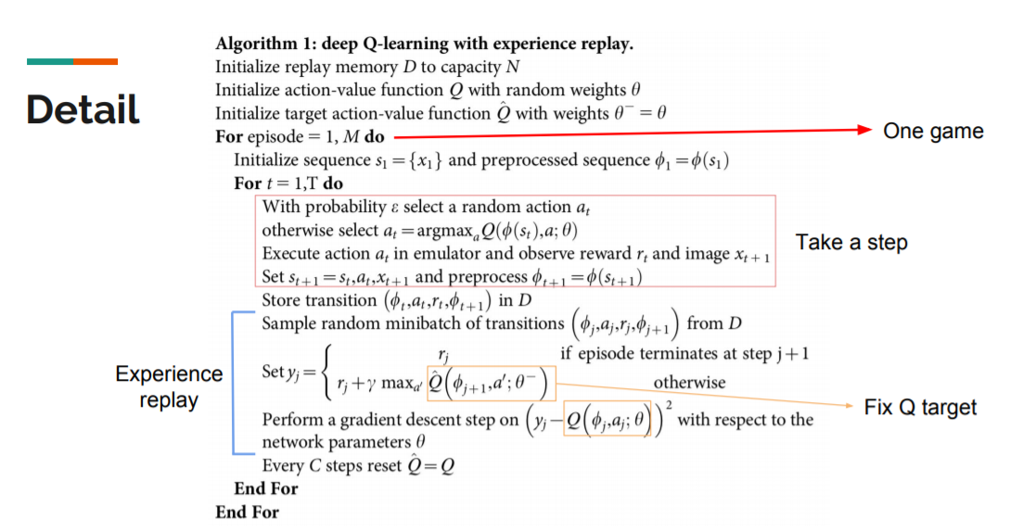

Slide 18
Deep Q Network - Endgame problem
When the Pacman has just few food particles to collect at the other end of the grid, it either chooses to become static or it keeps revolving around the same spots due to the ghosts.
The reason is the negative reward to reach the last food particle could seem larger then the reward it gets by collecting the food particles
So rewards will have to be adjusted accordingly during the last phases of game.

Slide 19
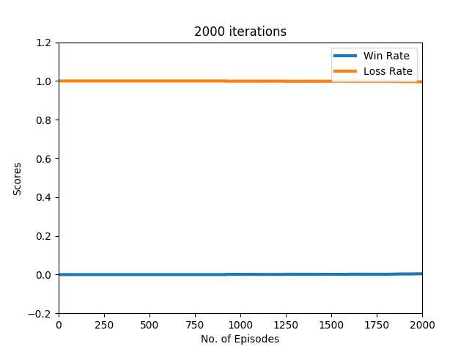
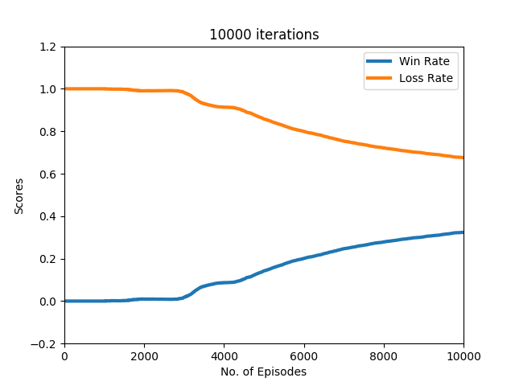
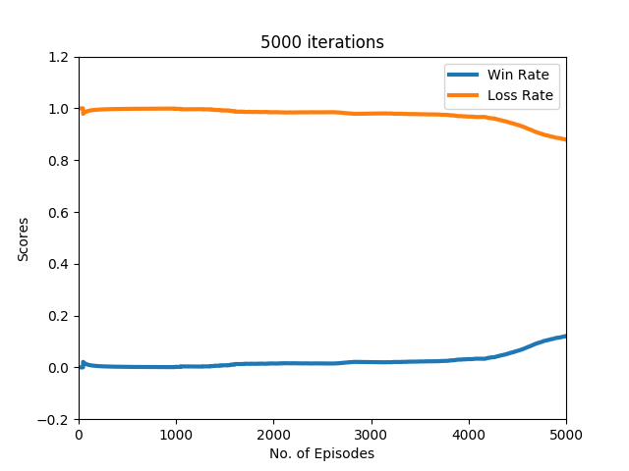
Results
Small Grid
$2^{9}$ states
5 actions

Slide 20
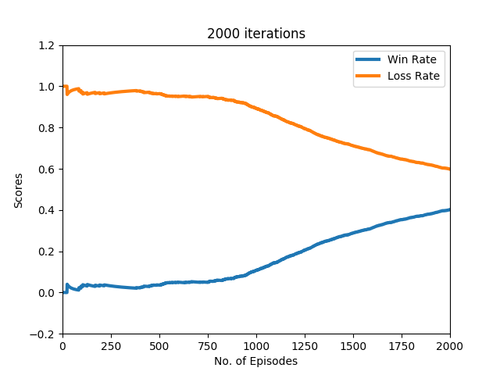
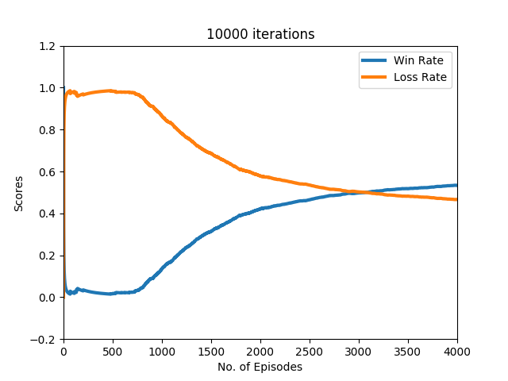
Results
Medium Grid
$2^{16}$ states
5 actions
4000

Slide 21

Results
Classic Grid
$2^{144}$ states
5 actions

Slide 22
Conclusion
We can conclude that the Q learning Algorithm performs poorly for a medium grid and a classic Pacman grid, even though it works well for a small Grid
The performance of the Approximate Q learning algorithm was significantly better than the simple Q learning algorithm. It was able to achieve a very high win rate after just 50 iterations on a medium grid and 100 iterations on a classic grid.
The performance of the Deep Q learning algorithm was lower than we expected however, we noticed that to train the algorithm we needed around 10000 iterations and it still wouldn’t always give us an optimal win.

Slide 23
Future Scope
We feel that this should be tested for an increased number of ghosts and the difficulty level can be increased with better ghost heuristics.
Be able to chase scared ghosts
For Exploration/Exploitation trade-off, instead of Epsilon-Greedy, another possible algorithm can be used.
We feel the Pacman game can be trained better using either a Deep Recurrent Q Learning Network or a Double Q Learning Network to improve the Deep Q learning algorithm. We found some papers dealing with these concepts, and by just an overview we feel it could deal with the endgame concept better.
Try learning from demonstration

Slide 24
References
[1] Berkeley Pacman Code http : //ai.berkeley.edu/projectoverview.html
[2] Volodymyr Mnih, Koray Kavukcuoglu, David Silver, Alex Graves, Ioannis Antonoglou, Daan Wierstra, and Martin Riedmiller. Playing atari with deep reinforcement learning. arXiv preprint arXiv:1312.5602, 2013
[3] Mnih et al. Human-level control through deep reinforcement learning. doi:10.1038/nature14236, 2015.
[4] Reinforcement Learning in Pacman http://cs229.stanford.edu/proj2017/final-reports/5241109.pdf

Slide 25
Pacman with Reinforcement Learning
Presentation Subtitle
Adheesh Chatterjee
Nitish Kumar S

